Slide 1
Track: Computer Vision
Team name: I_SEE_HACK
Gurojaspreet Kaur
Harshita
Gurjot Kaur
Palak Kaushik

Slide 2
Idea Overview
The goal is to develop and test a Deep Learning model that can analyse video feeds from a camera set-up in a car and detect instances for drivers such as -
drowsiness,
uneasiness,
lethargy
The objective is to develop a fully functional prototype that can be fitted into automobiles to improve road safety.
Beeping noise produced if driver is found to be drowsy or inactive to alert them.

Slide 3
Technical Overview
Building Model:
Using keras, an open source deep learning library, for training the dataset. Keras provides a user-friendly and faster means for data training and visualisation than using other models.
The processing of the Video feed will be done using MicroPython on a kernel level. This will increase the processing speed drastically which will be helpful to prevent life-threatening situations.
A faster and more efficient deployment of the algorithm will reduce processing power required and the time taken to analyse the data.

Slide 4
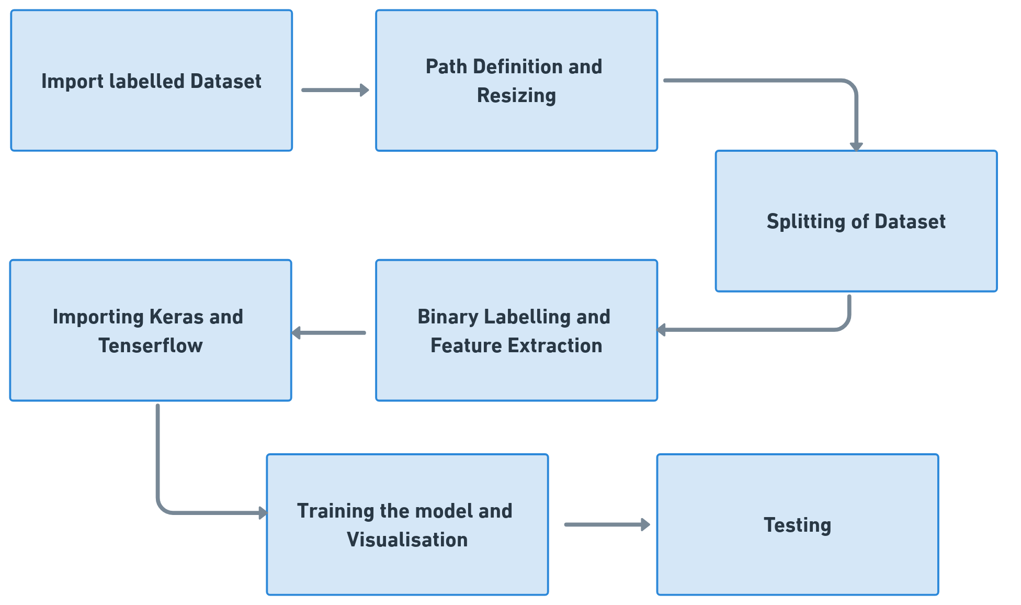
Execution
Model:

Slide 5
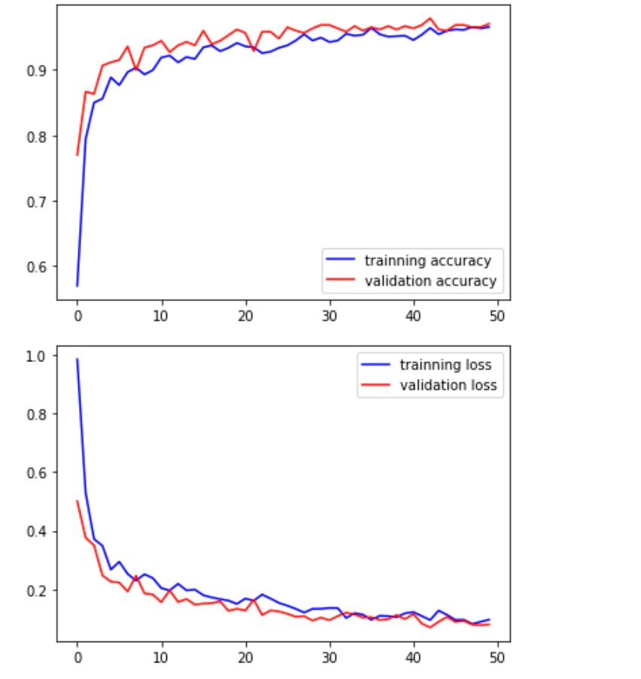
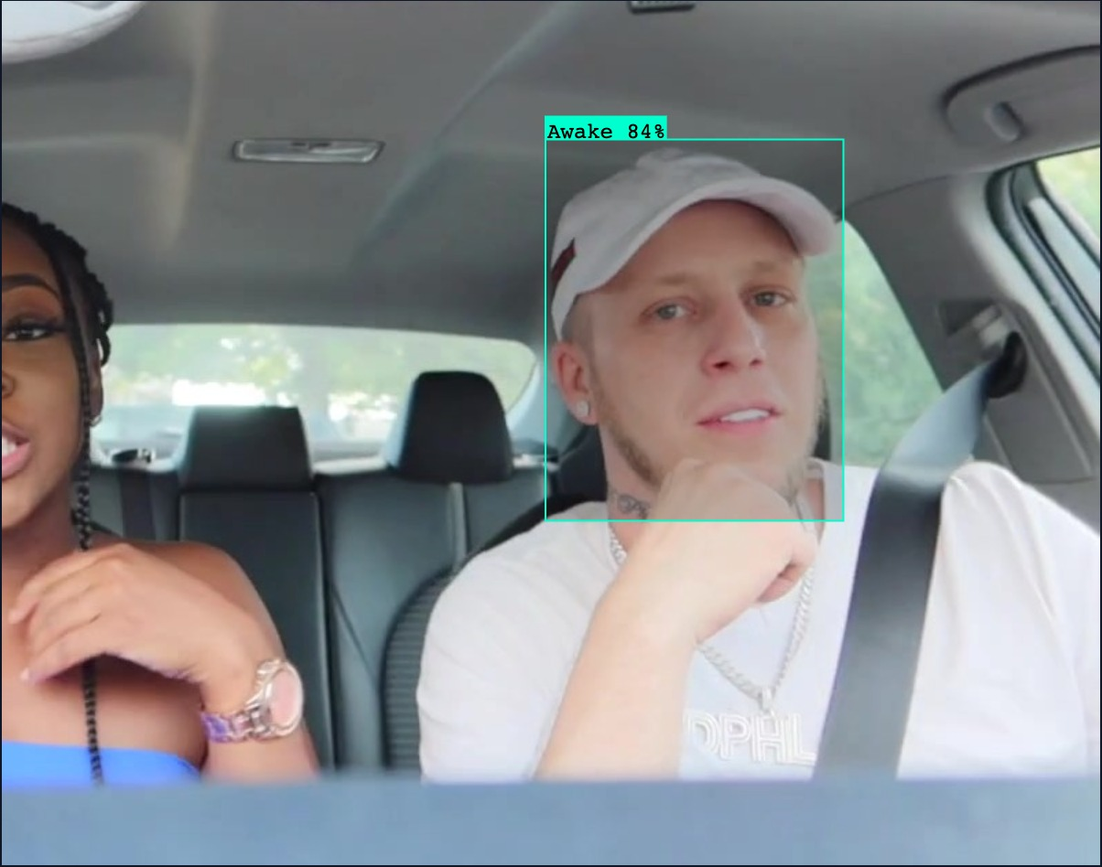
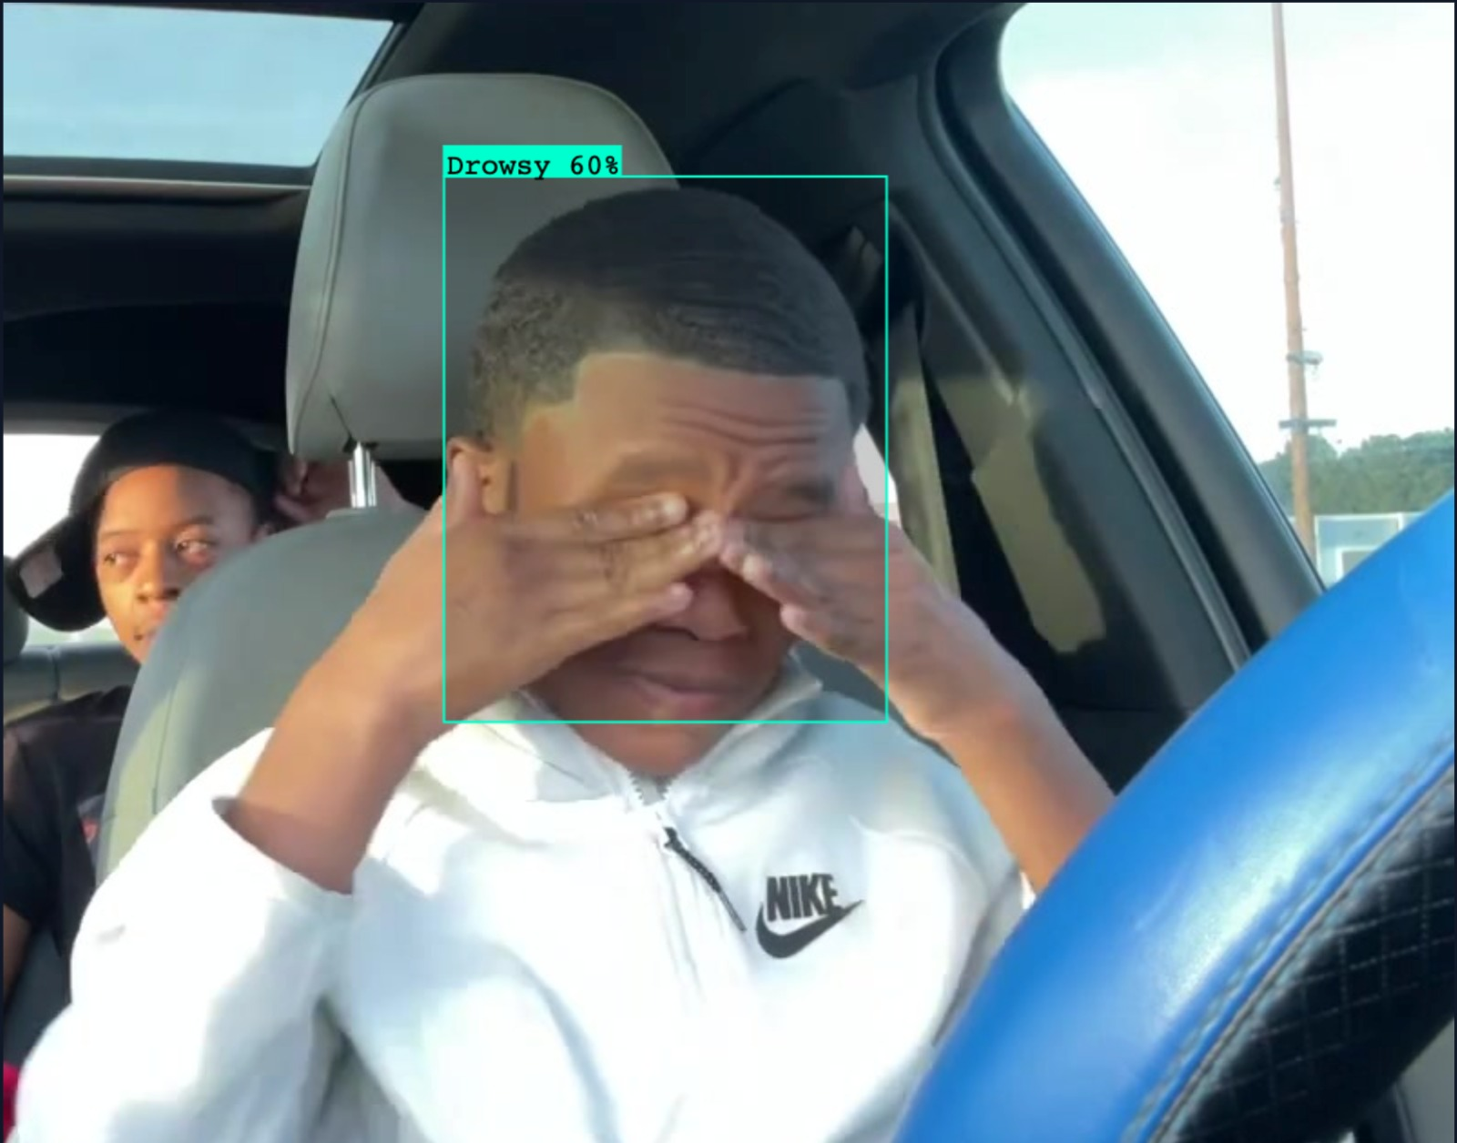
Model Output

Slide 6
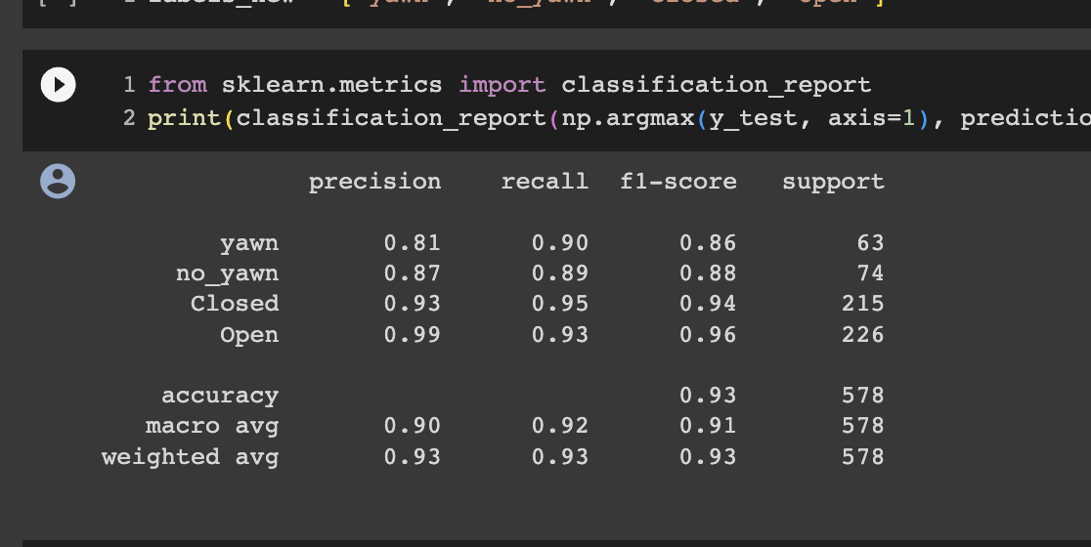
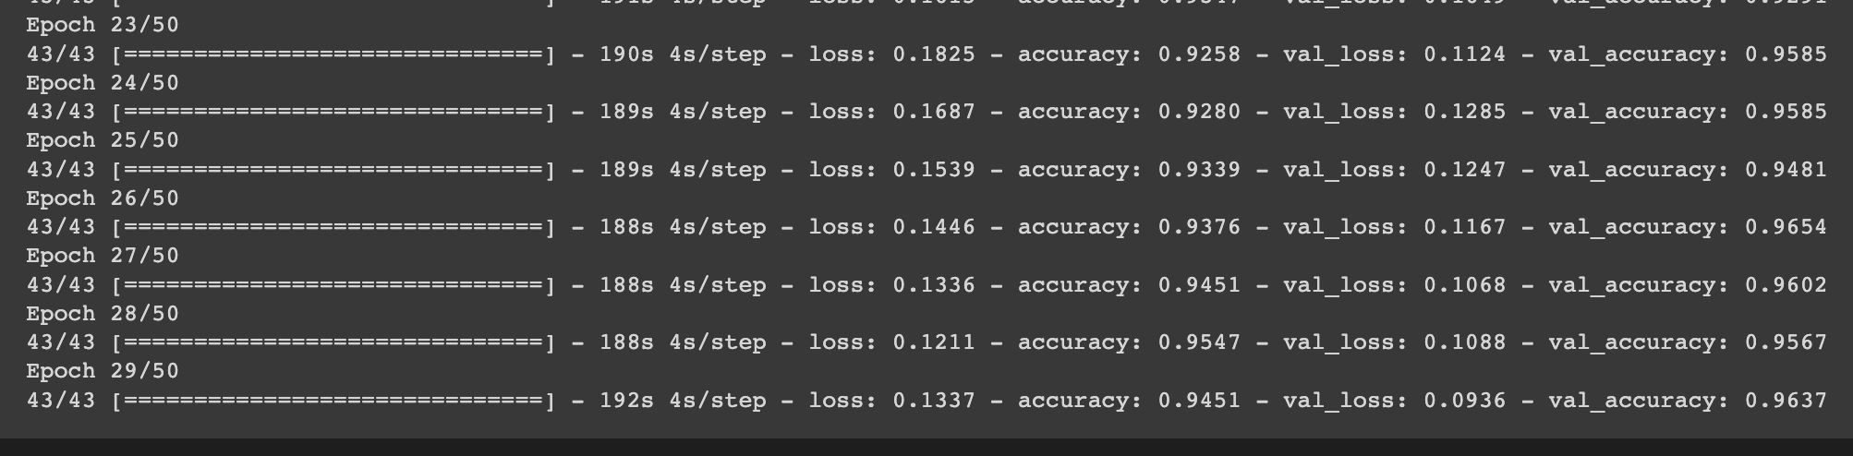
Model Output

Slide 7
Market Prospects
Potential: Can save lives and drastically reduce road instances happening due to driver drowsiness and lethargy.
Cost: It is cost effective, requiring just an initial investment for a pi-camera.
Time efficient: The processing will be done on a low-level so that it is much faster and highly scalable.
IoT and Connectivity: With Internet of Things (IoT) and vehicle connectivity, it's easier to collect and analyze real-time data from in-car systems.

Slide 8
Future Scope
Work can be done on model using data with drivers wearing spectacles/ glasses.
Position and angling of face can affect the alert system, an angling/rotating camera can be used.
The solution is highly scalable as it requires low processing power.

